Slide 1
yRelocate?
Group Two:
Joe Reynolds, Trupti Samant,
Maryam Samani, Trent Gebben and Bill Frye

Slide 2
Core Questions
Based on what a person values, can we identify what neighborhood a person should live in?
What factors can we use to determine what neighborhood a person would want to live in?
How can we classify people into different groups?

Slide 3




APIs/Data Sources Used

Slide 4
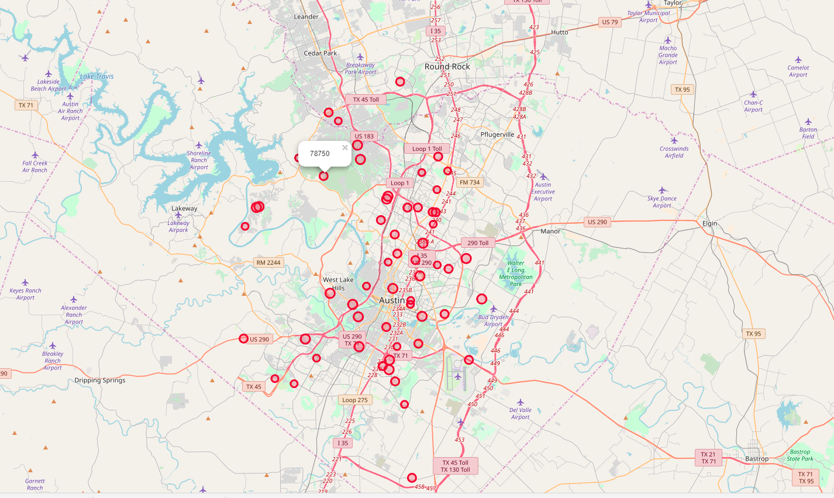
Example Family map based on school ratings

Slide 5
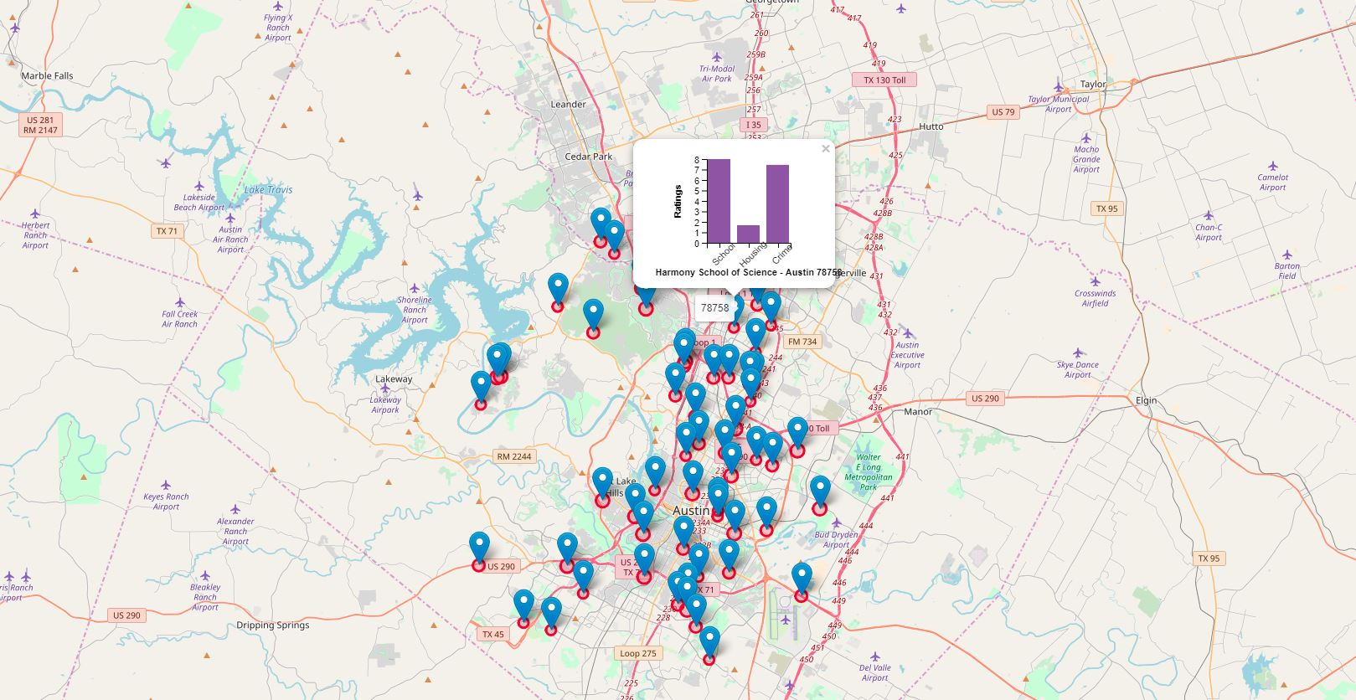
Example Family map based on school ratings

Slide 6
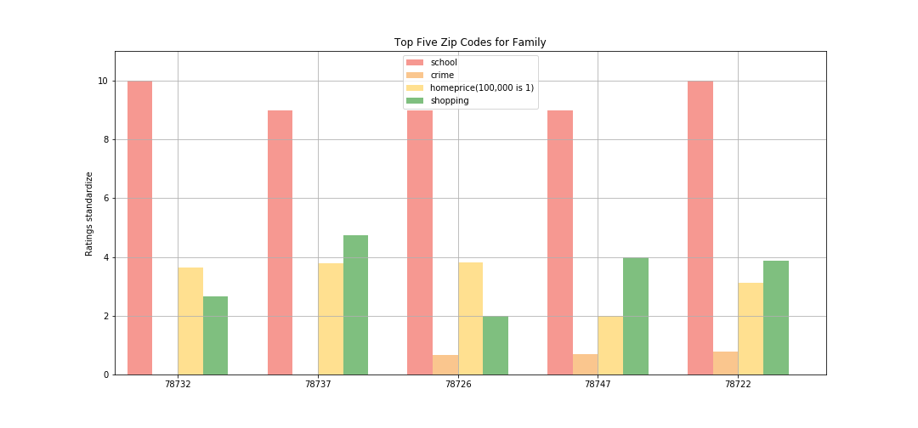
Family Findings on rating

Slide 7
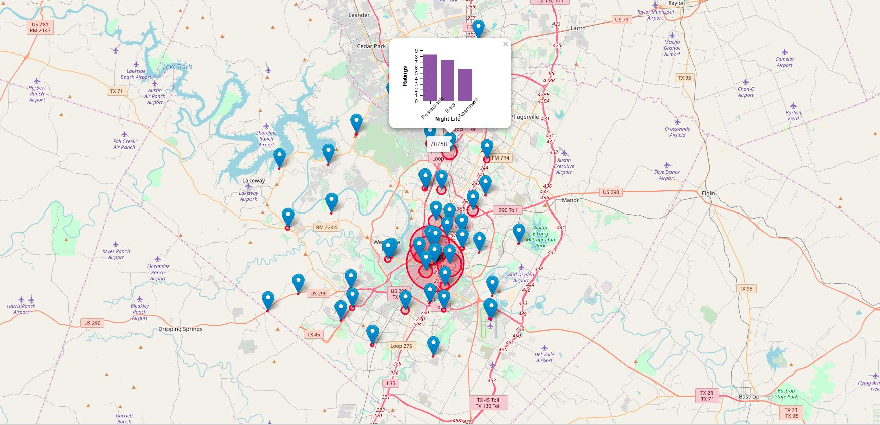
Example map for a single based on counts and Bar chart based on ratings

Slide 8
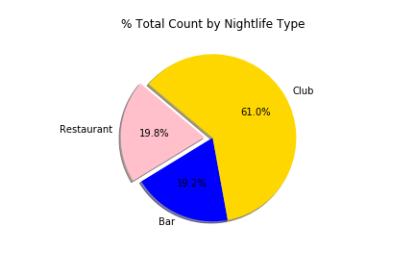
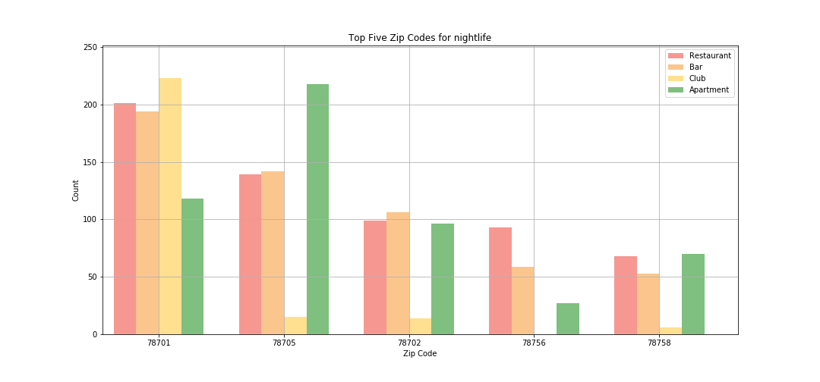
Nightlife Findings

Slide 9
Data Exploration and Clean Up
Finding the Right and Free APIs
Understand new data format for parsing ex. XML
Assumptions on what Certain groups of people value
Standardizing Ratings
Learning new packages like Folium

Slide 10
Expansion On Future Projects
Adding Front End
Adding more in-depth analysis
Removing assumptions
Adding more data
Expanding the search beyond Austin
Incorporating Machine Learning

